Slide 1
Giving directions
Krystyna Arnold

Slide 2
If you are looking for a place what do you need?
Car, bike, bus
Location (address)
Directions!

Slide 3
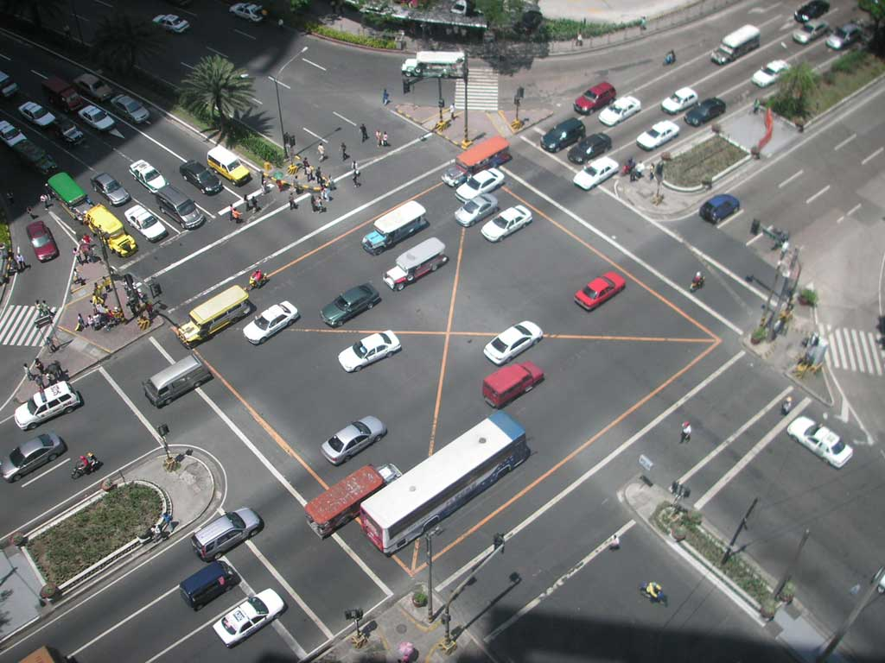
Intersection

Slide 4
Left

Slide 5
Right

Slide 6
Shortcut

Slide 7
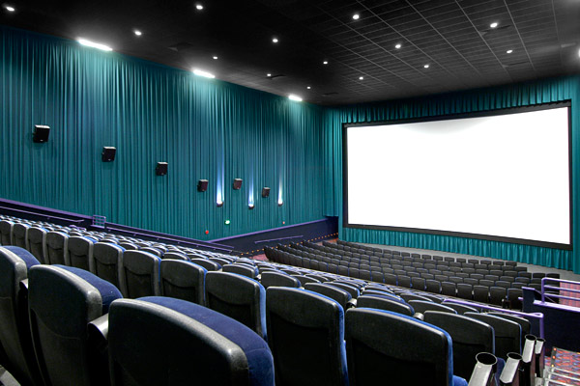
Movie theater

Slide 8
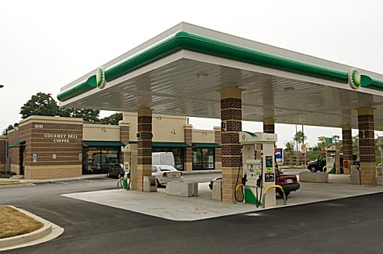
Gas station

Slide 9
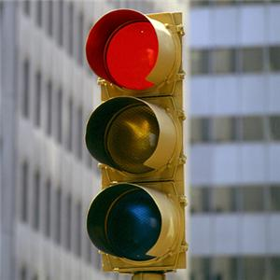
Light

Slide 10
Crosswalk

Slide 11
Stop

Slide 12
Matching
Find a partner and match the vocabulary to the picture.

Slide 13
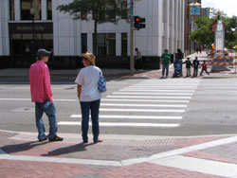
Matching

Slide 14
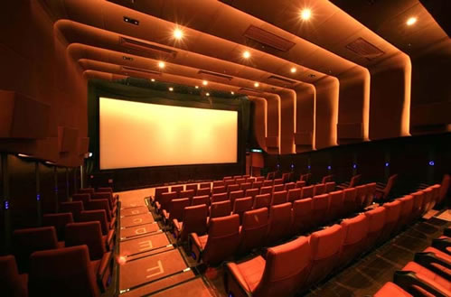
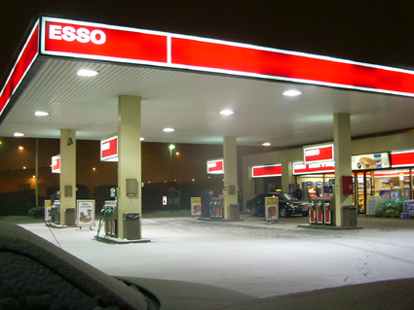
Matching

Slide 15
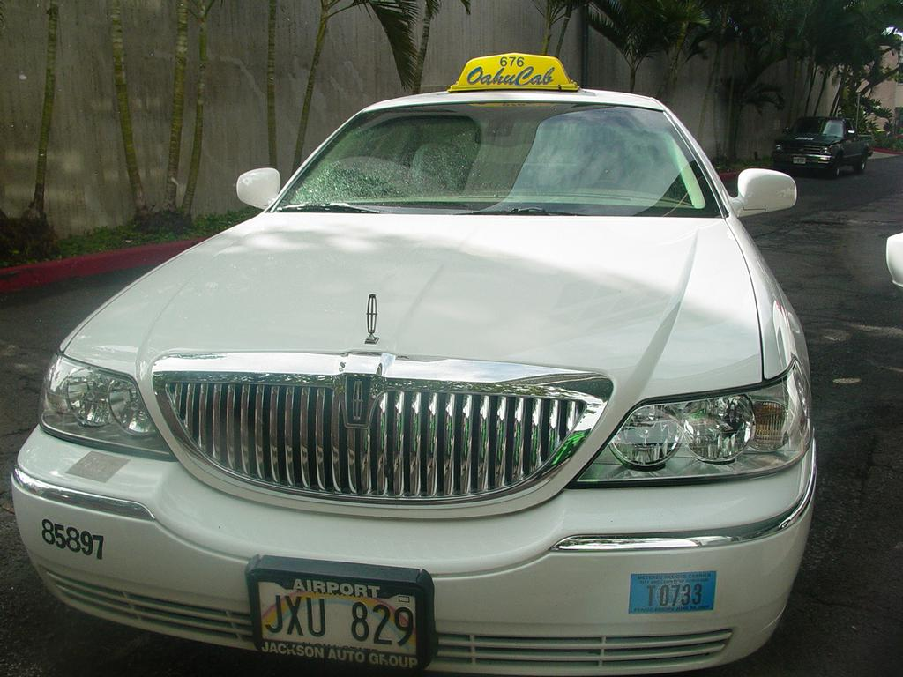
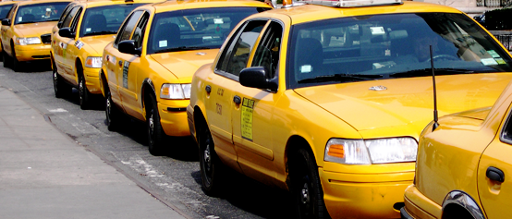
Let’s take a taxi!

Slide 16
Taxi
Discuss with a partner:
Where is the girl going?
She is going to the movie theater.
Why did she give the taxi driver directions?
She knew a shortcut.
Why was she lucky?
They made all the green lights.

Slide 17
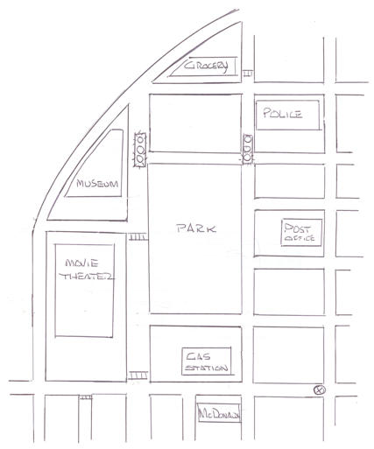
Listen carefully to the directions she gives the taxi driver and trace the path onto the map.

Slide 18
Where do you want to go?

Slide 19
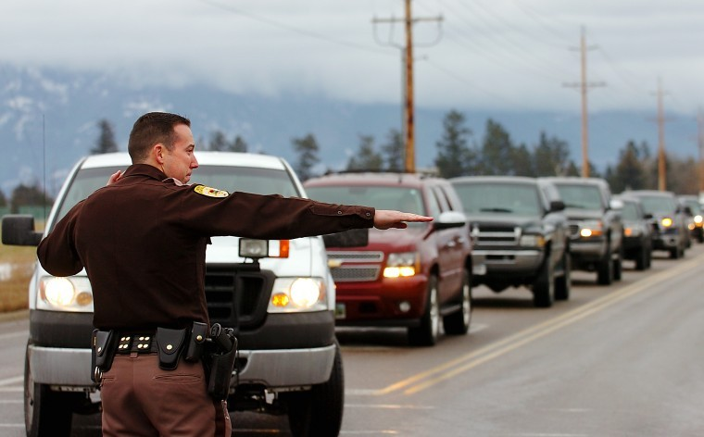
Think about it
Write down why you might need to give directions to somebody.

